Slide 1
A Consumption-Based Carbon Reduction Model
Team 16
Revolutionizing Sustainable Living
Name:
Sang Hyun Ha(56037830)
Seongmin Kang(55991040)
Yu Ka Wing(56982631)
Lav Asrani(56444472)
Chaejun Park(5577164)

Slide 2



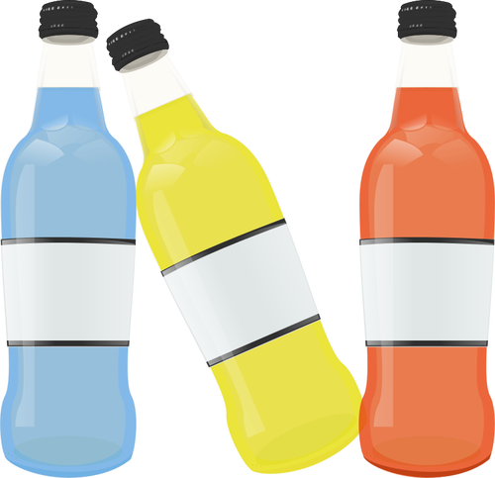










THE IDEAL GREEN CITY

Slide 3

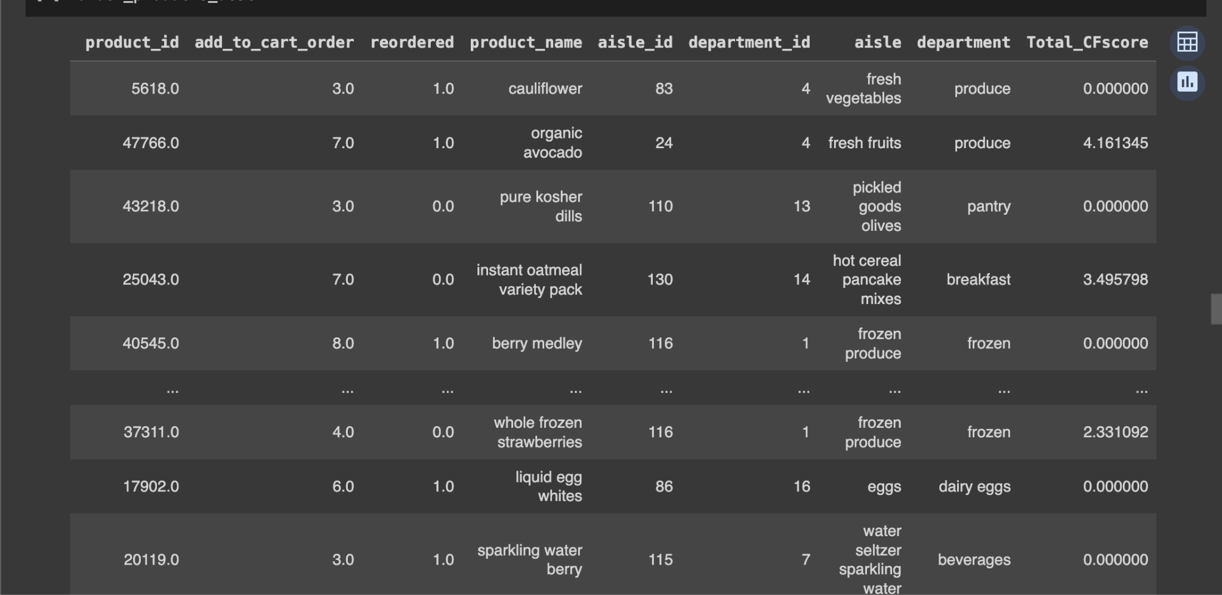

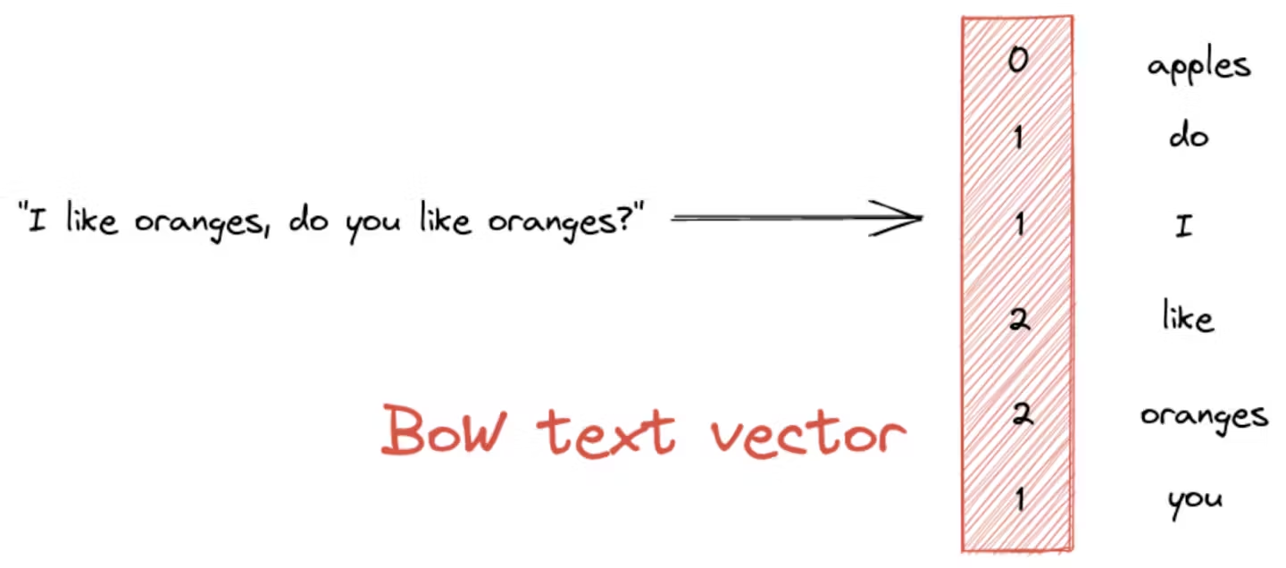
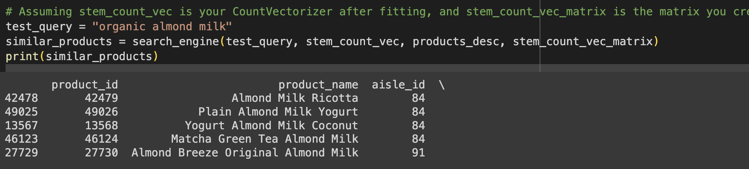
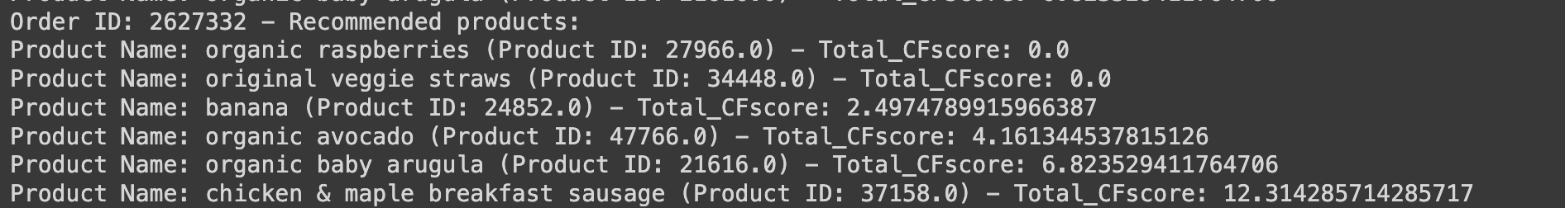
Coding and technical parts
01
02
03
04
05
06
Rating
Data cleaning and Integrating
EDA(Exploratory data analysis
Making Carbon footprint scoring Scheme
From Kaggle
1) Grocery Data
2) Food Carbon Footprinting
Search Engine using Natural language processing
Recommendation
System using surprise
Prototypes & Apps

Slide 4

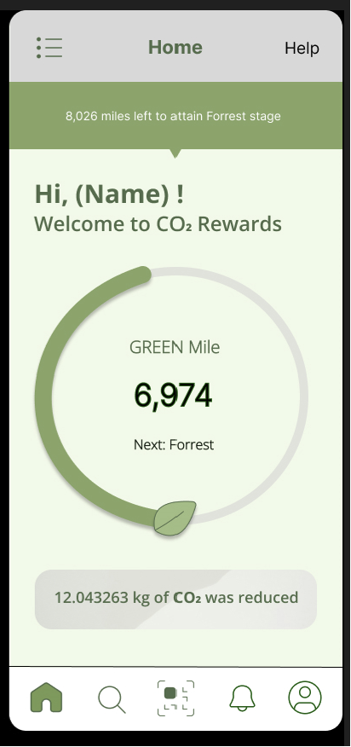
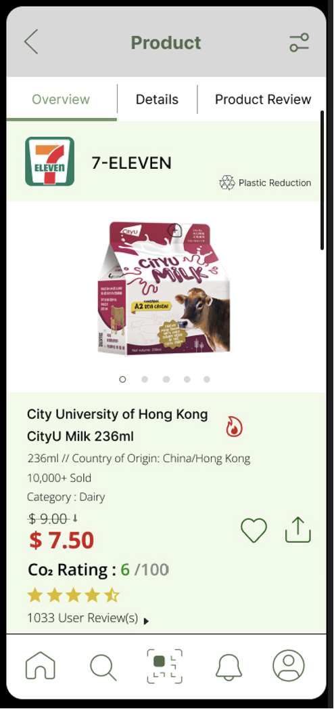


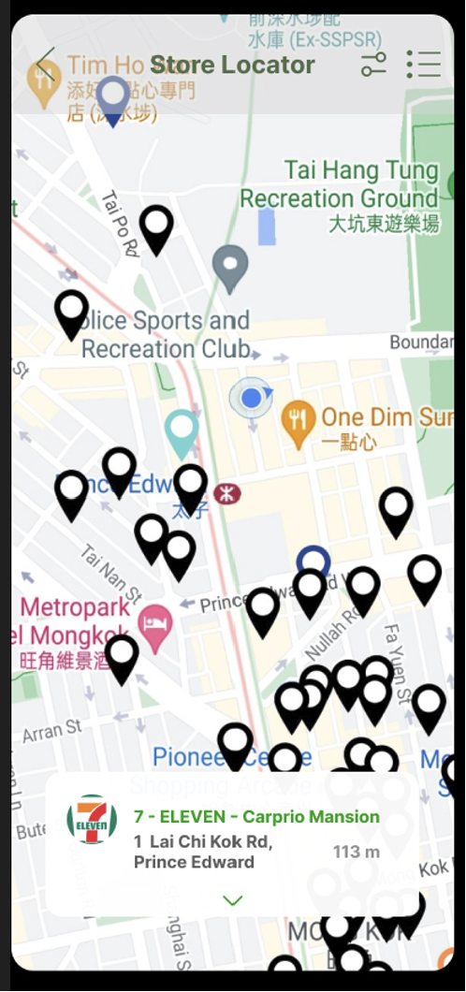
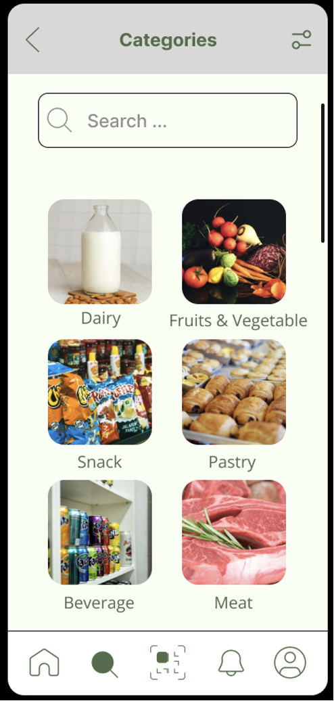
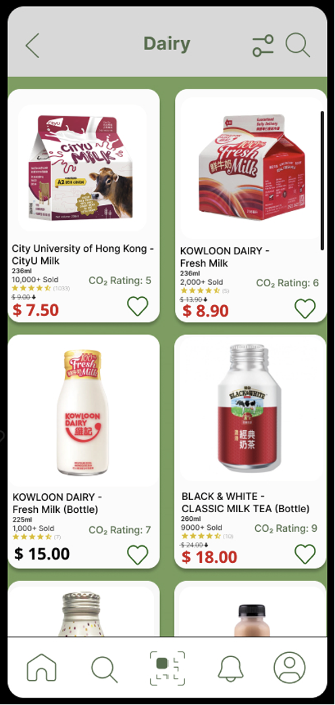
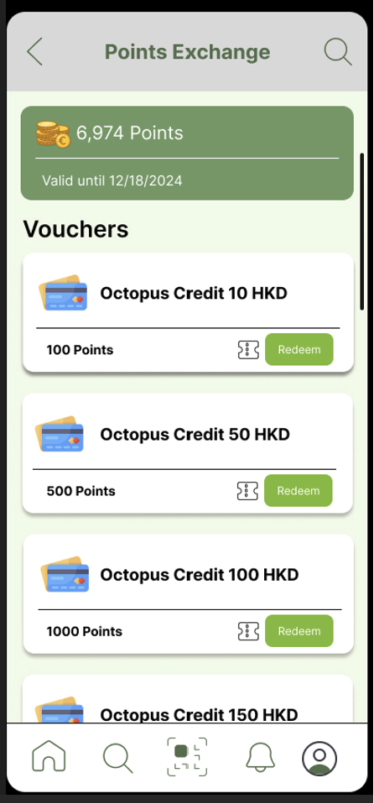
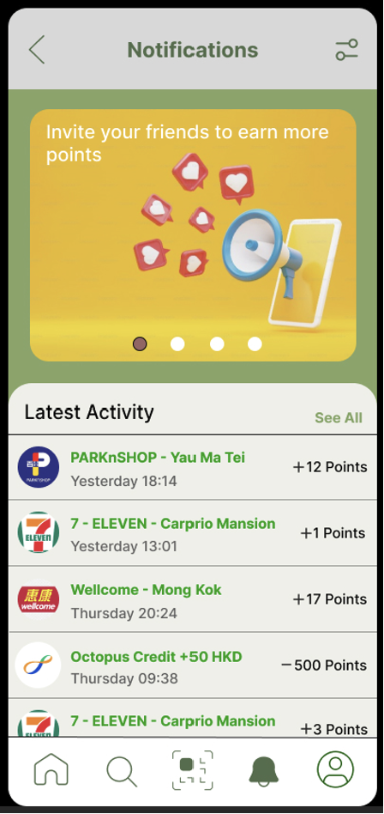
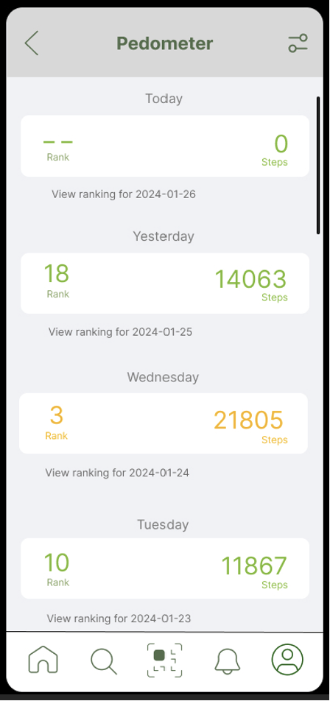
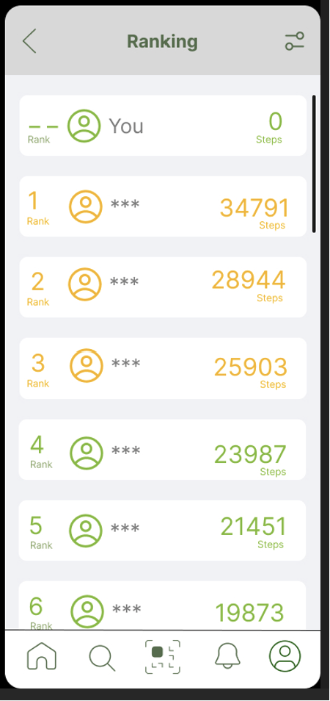
App Interface

Slide 5
Benefits
Environmental Conservation
Economical Boost
Educates Environmental Awareness
Motivates Companies Reform
Creates Positive Feedback Loop

Slide 6
Future Works
Conclusion
Reference
Incorporate Additional Features
Promote Eco-Friendly Activities
https://github.com/melodygr/grocery_recommendation?tab=readme-ov-file

